Slide 1

Hive - A Warehousing Solution Over a Map-Reduce Framework

Slide 2
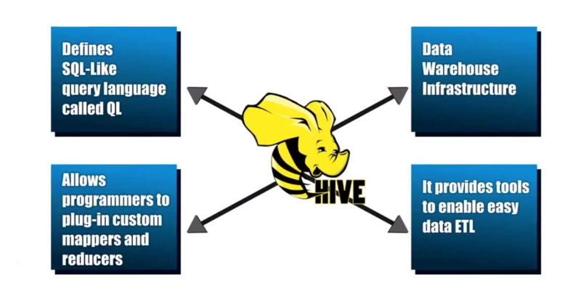
Hive Key Principles
Notes:
Data Warehouse - A system used for reporting and data analysis. DWs are central repositories of integrated data from one or more disparate sources
ETL – process of extracting data from source and bringing it into data warehouse. Extract Transform and Load.

Slide 3

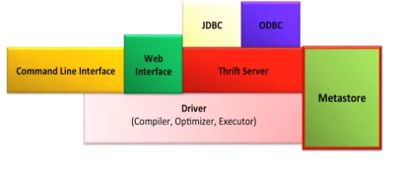
HiveQL to MapReduce
Hive Framework
N
Data Analyst
SELECT COUNT(1) FROM Sales;
rowcount, N
rowcount,1
rowcount,1
Sales: Hive table
MR JOB Instance

Slide 4
Hive Data Model
Data in Hive organized into :
Tables
Partitions
Buckets

Slide 5
Hive Data Model Contd.
Tables
- Analogous to relational tables
Each table has a corresponding directory in HDFS
Data serialized and stored as files within that directory
- Hive has default serialization built in which supports compression and lazy deserialization
- Users can specify custom serialization –deserialization schemes (SerDe’s)

Slide 6
Hive Data Model Contd.
Partitions
Each table can be broken into partitions
Partitions determine distribution of data within subdirectories
Example -
CREATE_TABLE Sales (sale_id INT, amount FLOAT)
PARTITIONED BY (country STRING, year INT, month INT)
So each partition will be split out into different folders like
Sales/country=US/year=2012/month=12

Slide 7
Hierarchy of Hive Partitions
/hivebase/Sales
/country=US
/country=CANADA
/year=2012
/year=2012
/year=2015
/year=2014
/month=12
/month=11
/month=11
File
File
File
Notes:
Partitioned tables can be created using the PARTITIONED BY clause. A table can have one or more partition columns and a separate data directory is created for each distinct value combination in the partition columns. Further, tables or partitions can be bucketed using CLUSTERED BY columns, and data can be sorted within that bucket via SORT BY columns. This can improve performance on certain kinds of queries.

Slide 8
Hive Data Model Contd.
Buckets
Data in each partition divided into buckets
Based on a hash function of the column
H(column) mod NumBuckets = bucket number
Each bucket is stored as a file in partition directory

Slide 9
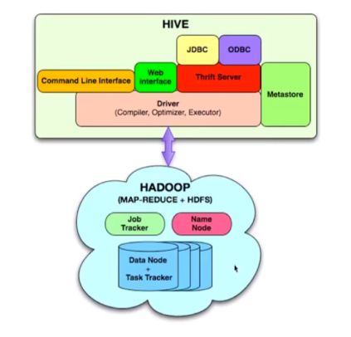
Architecture
Externel Interfaces- CLI, WebUI, JDBC, ODBC programming interfaces
Thrift Server – Cross Language service framework .
Metastore - Meta data about the Hive tables, partitions
Driver - Brain of Hive! Compiler, Optimizer and Execution engine

Slide 10
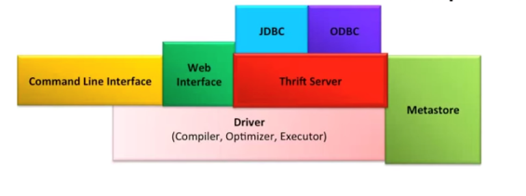
Hive Thrift Server
Framework for cross language services
Server written in Java
Support for clients written in different languages
- JDBC(java), ODBC(c++), php, perl, python scripts

Slide 11

Metastore
System catalog which contains metadata about the Hive tables
Stored in RDBMS/local fs. HDFS too slow(not optimized for random access)
Objects of Metastore
Database - Namespace of tables
Table - list of columns, types, owner, storage, SerDes
Partition – Partition specific column, Serdes and storage
Notes:
Metadata for table contains list of columns and their types, owner, storage and SerDe information. It can also contain any user supplied key and value data; this facility can be used to store table statistics in the future. Storage information includes location of the ta- ble’s data in the underlying file system, data formats and bucketing information. SerDe metadata includes the implementation class of serializer and deserializer methods and any supporting information required by that implementation.
Hive now records the schema version in the metastore database and verifies that the metastore schema version is compatible with Hive binaries that are going to accesss the metastore. Note that the Hive properties to implicitly create or alter the existing schema are disabled by default. Hive will not attempt to change the metastore schema implicitly. When you execute a Hive query against an old schema, it will fail to access the metastore.

Slide 12
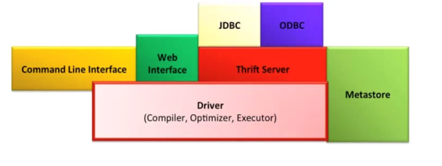
Hive Driver
Driver - Maintains the lifecycle of HiveQL statement
Query Compiler – Compiles HiveQL in a DAG of map reduce tasks
Executor - Executes the tasks plan generated by the compiler in proper
dependency order. Interacts with the underlying Hadoop instance

Slide 13
Compiler
Converts the HiveQL into a plan for execution
Plans can
- Metadata operations for DDL statements e.g. CREATE
- HDFS operations e.g. LOAD
Semantic Analyzer – checks schema information, type checking, implicit type conversion, column verification
Optimizer – Finding the best logical plan e.g. Combines multiple joins in a way to reduce the number of map reduce jobs, Prune columns early to minimize data transfer
Physical plan generator – creates the DAG of map-reduce jobs
Notes:
These repartition operators mark the boundary between the map phase and a reduce phase during physical plan generation.

Slide 14
HiveQL
DDL :
CREATE DATABASE
CREATE TABLE
ALTER TABLE
SHOW TABLE
DESCRIBE
DML:
LOAD TABLE
INSERT
QUERY:
SELECT
GROUP BY
JOIN
MULTI TABLE INSERT
Notes:
The EXTERNAL keyword lets you create a table and provide a LOCATION so that Hive does not use a default location for this table. This comes in handy if you already have data generated. When dropping an EXTERNAL table, data in the table is NOT deleted from the file system.

Slide 15
Good Things
Boon for Data Analysts
Easy Learning curve
Completely transparent to underlying Map-Reduce
Partitions(speed!)
Flexibility to load data from localFS/HDFS into Hive Tables

Slide 16
Cons and Possible Improvements
Extending the SQL queries support(Updates, Deletes)
Parallelize firing independent jobs from the work DAG
Table Statistics in Metastore
Explore methods for multi query optimization
Perform N- way generic joins in a single map reduce job
Better debug support in shell

Slide 17
When to Use Hive
If you have large (think terabytes/petabytes) datasets to query: Hive is designed specifically for analytics on large datasets and works well for a range of complex queries. Hive is the most approachable way to quickly (relatively) query and inspect datasets already stored in Hadoop.
If extensibility is important: Hive has a range of user function APIs that can be used to build custom behavior in to the query engine. Check out my guide to Hive functions if you’d like to learn more.

Slide 18
When to Use MySQL
If performance is key: If you need to pull data frequently and quickly, such as to support an application that uses online analytical processing (OLAP), MySQL performs much better. Hive isn’t designed to be an online transactional platform, and thus performs much more slowly than MySQL.
If your datasets are relatively small (gigabytes): Hive works very well in large datasets, but MySQL performs much better with smaller datasets and can be optimized in a range of ways.
If you need to update and modify a large number of records frequently: MySQL does this kind of activity all day long. Hive, on the other hand, doesn’t really do this well (or at all, depending). And if you need an interactive experience, use MySQL.

Slide 19
Difference between Hive and RDBMS
Hive | RDBMS
Hive enforces schema on read i.e schema does’t not verify loading data. | RDBMS enforces schema on write i.e schema verify loading data,else rejected.
Hive is based on the notion of Write once, Read many times. | RDBMS is designed for Read and Write many times.
Hive data size is Petabytes | In RDBMS, maximum data size is Terabytes
Hive doesn’t support OLTP (Online Transaction Processing) but it support OLAP (Online Analytical Processing) | RDBMS supports only OLTP.
Hive is suited for static data analysis(non real time data) example text file. | RDBMS is best suited for dynamic data analysis(real time data) example data from the sensors and web feeds.
Record level updates is not possible in Hive | Record level updates, insertions, Deletes and transactions are possible.

Slide 20
Continues…
Hive is very easily scalable at low cost | RDBMS is not scalable to low cost,because it provide solution to the customers.
Hive resembles a traditional DB by supporting SQL but it is not a database. | It is a database.
No support for indexes because data is always scanned. | Supports indexes, it is very important for Performance.
Distributed processing done via map/reduce | Distributed processing varies by vendor(company or person).
Scales up to hundred of nodes. | Scales to beyond 20 nodes.

